Slide 1
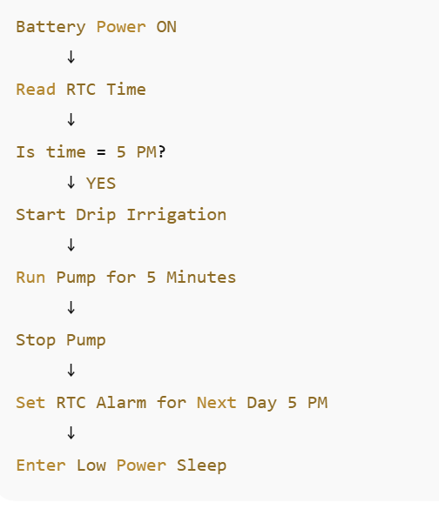
Indoor Drip Irrigation Using RTC

Slide 2
Battery powers STM32
RTC connected to STM32
RTC draws only 3 microampere current
Initially ----> STM32 is in Sleepmode
RTC raise an Alarm Pin at 5 pm
STM32 wakes up
Turn on Motor
Irrigation starts (Battery slowly discharges) + LED ON
Delay 5 min
Relay OFF
LED OFF
Next alarm set for next day 5 PM
STM32 goes back to sleep

Slide 3
